Slide 1
POS SYSTEM By Furqan ahmed

Slide 2
MODULES
Supermarket Icon.
Welcome screen & Main menu.
Admin Login screen.
Admin module menu.
Add a product in a text file.
Delete a product form text file.
Modify a product in the text file.
Search a product from the list.
Display all products.
A function for customer orders and bills.

Slide 3

SUPERMARKET ICON

Slide 4
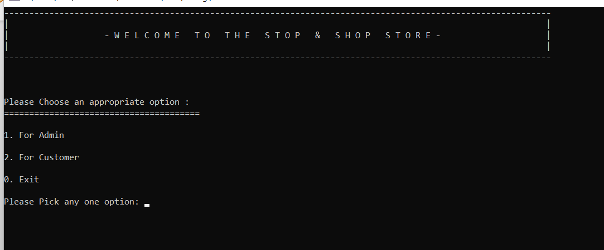
WELLCOME PAGE & MAIN MENU:

Slide 5
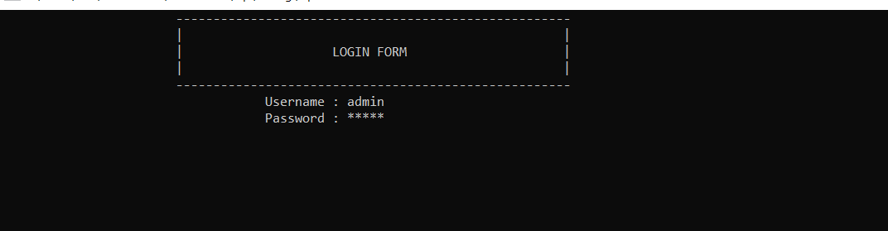
Admin Login Screen:

Slide 6
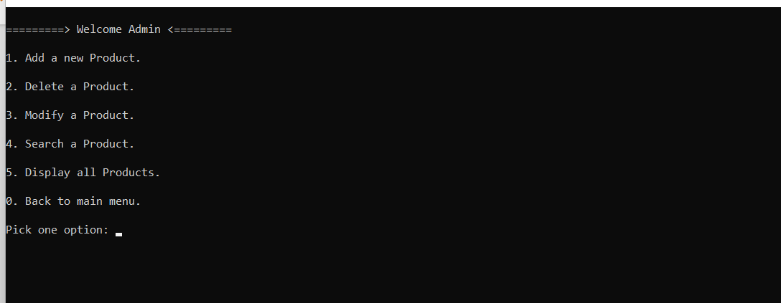
ADMIN MENU:

Slide 7
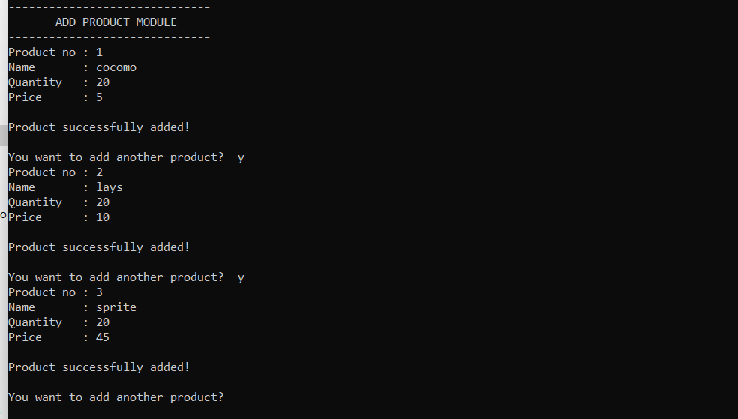
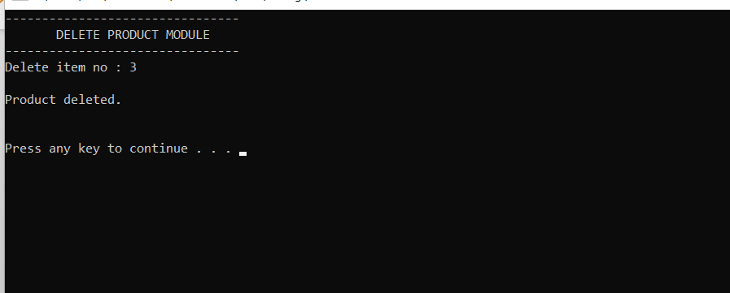
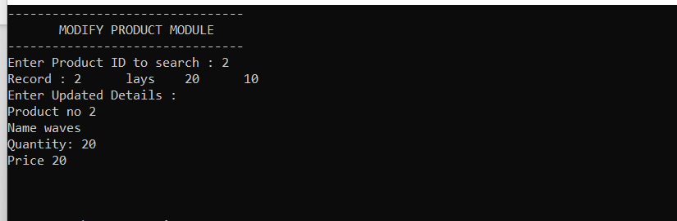
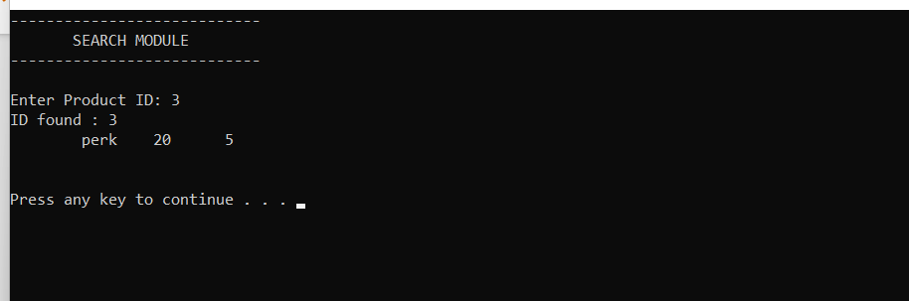
Add a product in a text file, Delete a product from a text file, Modify a product in the text file, Search a product from the list.

Slide 8
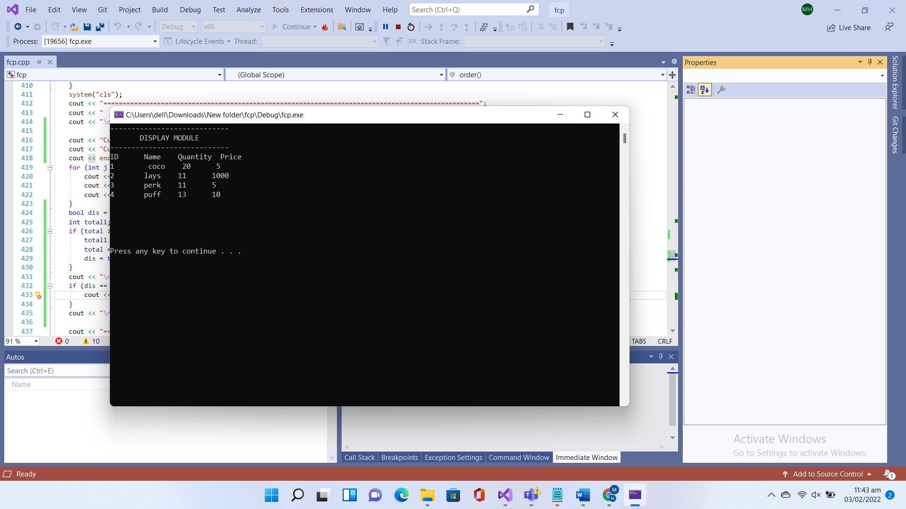
DISPLAY ALL PRODUCTS:

Slide 9
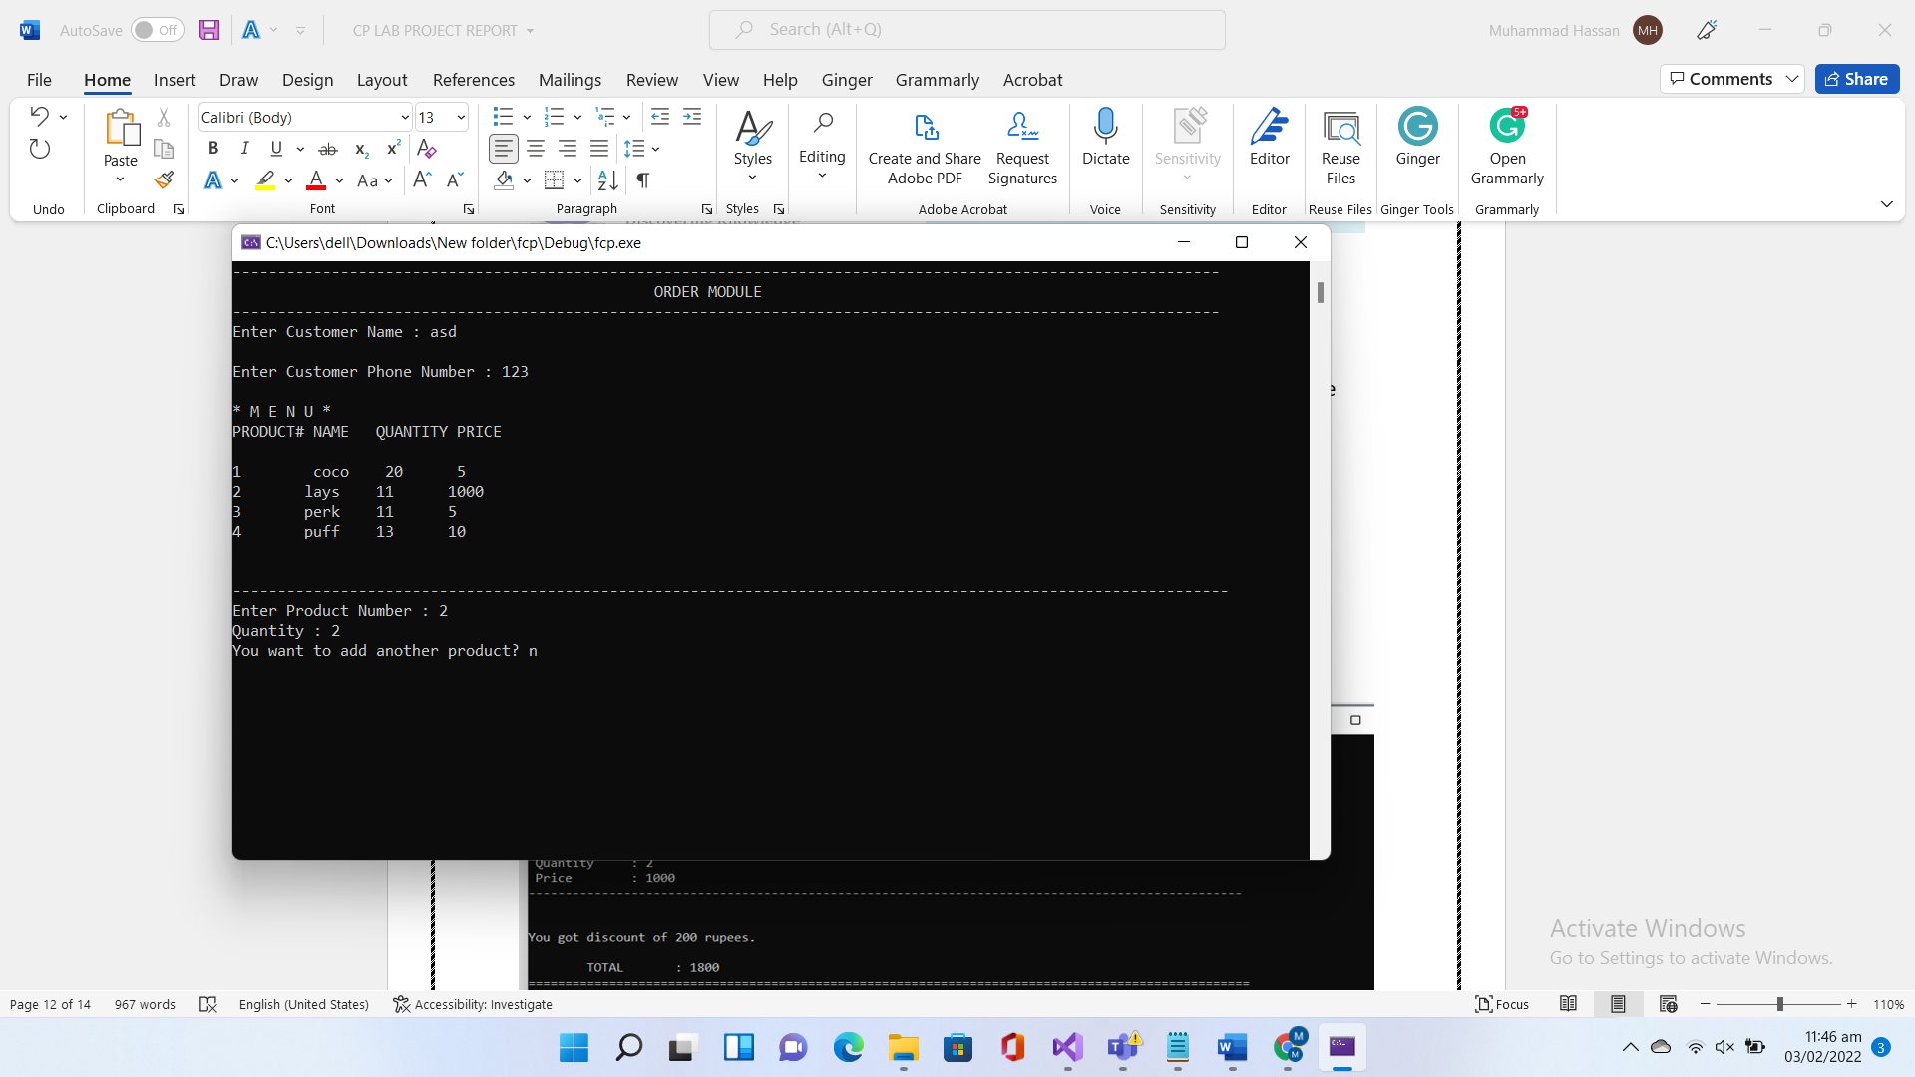
CUSTOMER MODULE:

Slide 10
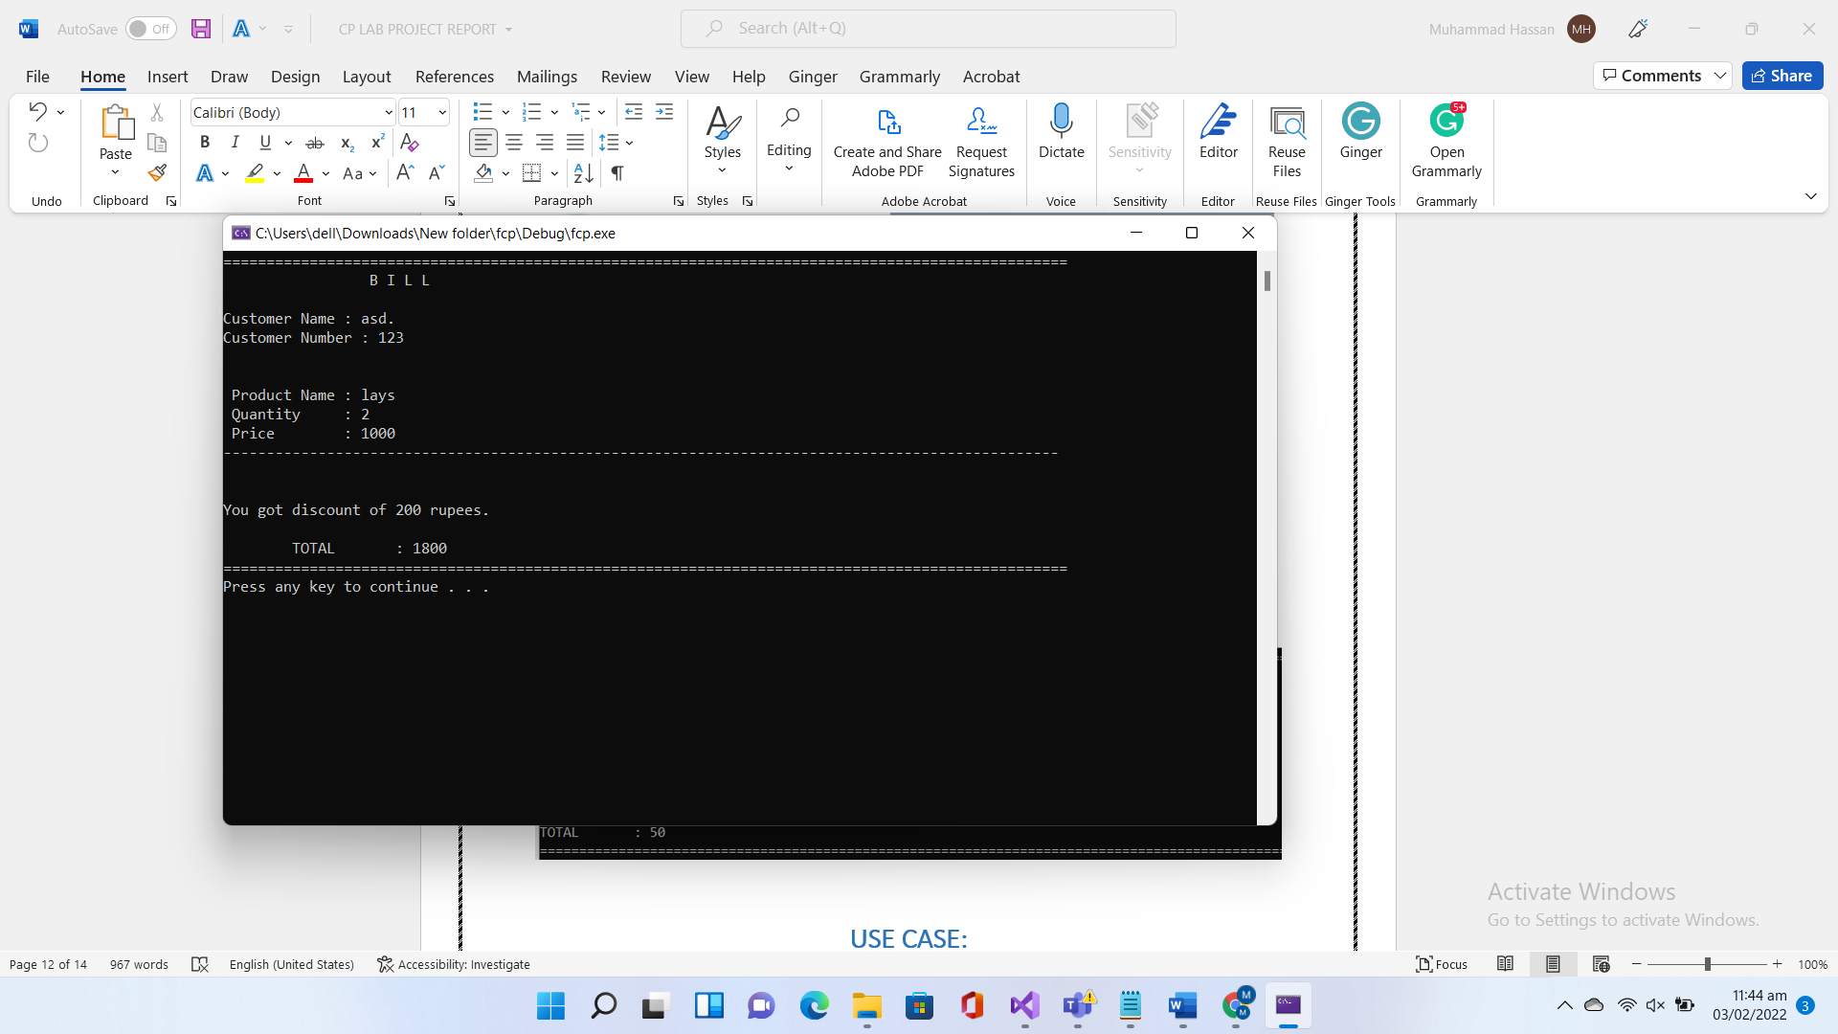
BILL

Slide 11
THANK YOU

